Slide 1

UE20CS390A – Capstone Project Phase – 1
Project Progress Review #3
Project Title : AI Based RoP Detection
Project ID : PW23_GS_01
Project Guide : Dr. Gowri Srinivasa
Project Team with SRN : Capstone_088_095_096_527
Atharva_S_Gadad_Ayush_Gupta_Ayush_Govind_Dhruv_Jyoti_Garodia

Slide 2
AI Based RoP Detection
Abstract and Scope
Introduction
RoP is a degenerative disease occurring frequently in underweight preterm infants
On delivery, the sudden shift from Hypoxia to Hyperoxia causes vasoconstriction and obliteration of vessels.
New blood vessels are formed via vascular endothelial growth factor (VEGF)
A tractional pull is applied onto the retina due to Fibrovascular Proliferation leading to retinal detachment and ultimately, permanent vision loss.
Project Scope
Using the fundus images of the patients to classify the images into RoP or not RoP
Classifying the fundus images suffering from RoP based on the stages of RoPs
Building interpretable models
Atharva_S_Gadad_Ayush_Gupta_Ayush_Govind_Dhruv_Jyoti_Garodia

Slide 3
AI Based RoP Detection
Suggestions from Review - 2
Solution to handling the large volume of data made available to us
Mapping of each visit to corresponding data in the spreadsheets
Pre-Processing of the data
Implementation of baselines
Atharva_S_Gadad_Ayush_Gupta_Ayush_Govind_Dhruv_Jyoti_Garodia

Slide 4
AI Based RoP Detection
Design Approach
What is the design approach followed? And Why?
→ We follow a Lean Design Approach,
min waste and max deliverable output
involves understanding of the Minimum Viable Product(MVP)
design according to users specific needs
implementation is not heavy towards fancy product delivery.
→ Benefits
reduces time-to-market
allows rapid experimentation, exploration and iterative feedback
potential to capture more market.
→ Drawback
challenge to balance product quality and target timeline
Atharva_S_Gadad_Ayush_Gupta_Ayush_Govind_Dhruv_Jyoti_Garodia

Slide 5
AI Based RoP Detection
Design Constraints, Assumptions & Dependencies
Storing and processing of high dimensional dataset at hand
Our dataset is skewed towards the class of patients marked for a follow up routine check
We assume that there has been no technical error in recording the fundus images
Generate mapping between patient id and encoded name assigned
Tallying the csv having patients details with the actual dataset available as folder or subfolders.
Atharva_S_Gadad_Ayush_Gupta_Ayush_Govind_Dhruv_Jyoti_Garodia

Slide 6
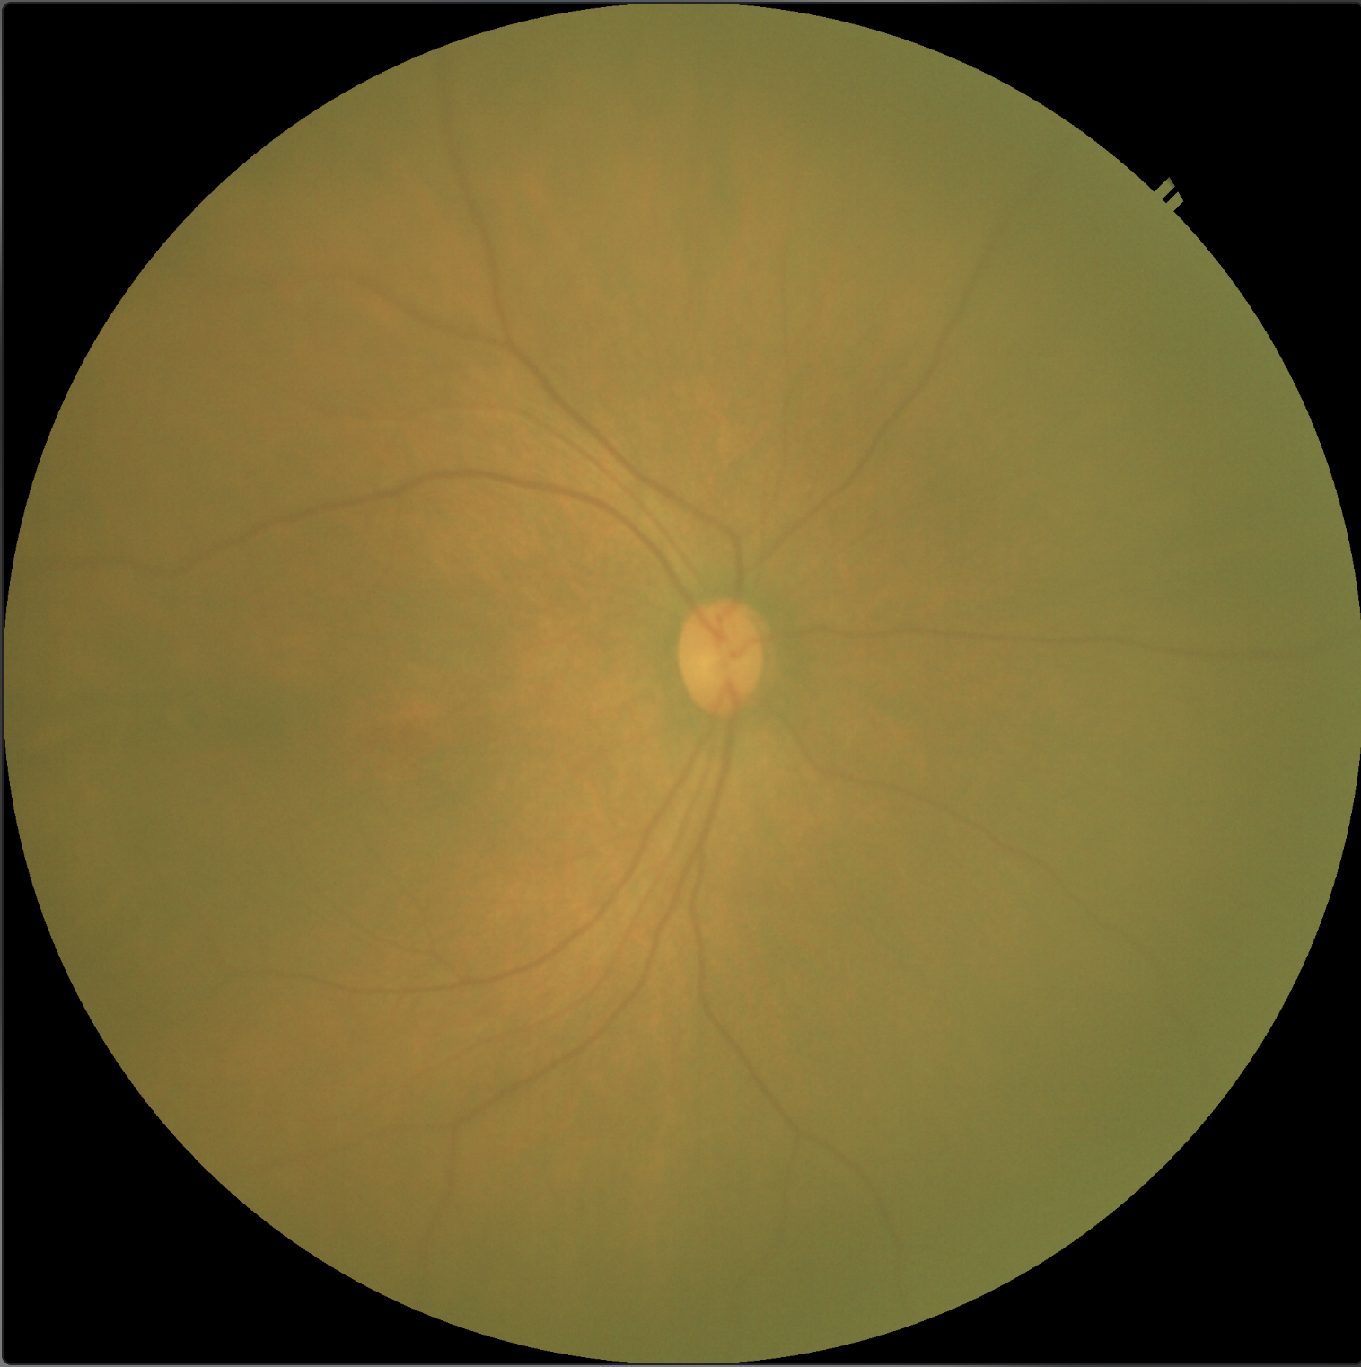
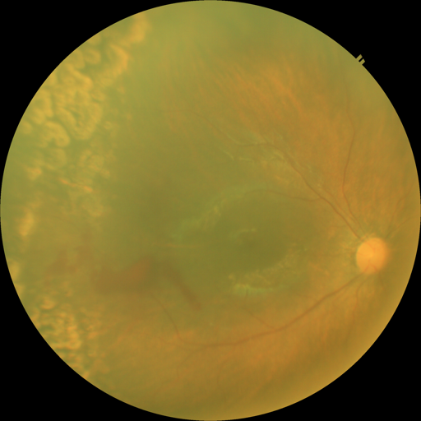
AI Based RoP Detection
Proposed Methodology / Approach
Directory Structure (Patient IDs)
Sub-directory structure (Visits)
Excel Sheet
Python Scripts
Discrepancies
Removal of thumbnail images
Optic disc and optic cup image segmentation
Size of gaussian window used
Using mean from image array
Using standard deviation from image array
Reduction in dataset size by image resizing
fundus image of a preterm baby
probable laser burns
Atharva_S_Gadad_Ayush_Gupta_Ayush_Govind_Dhruv_Jyoti_Garodia

Slide 7
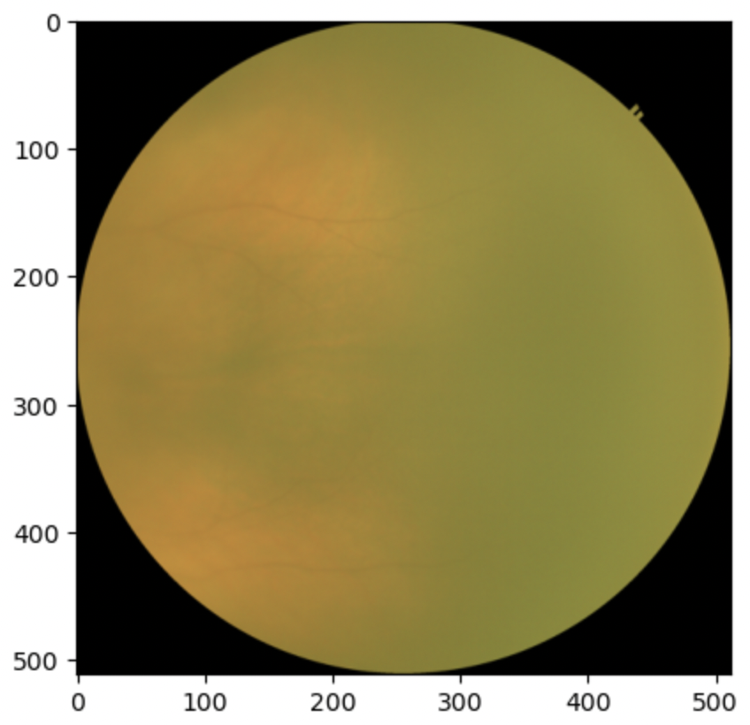

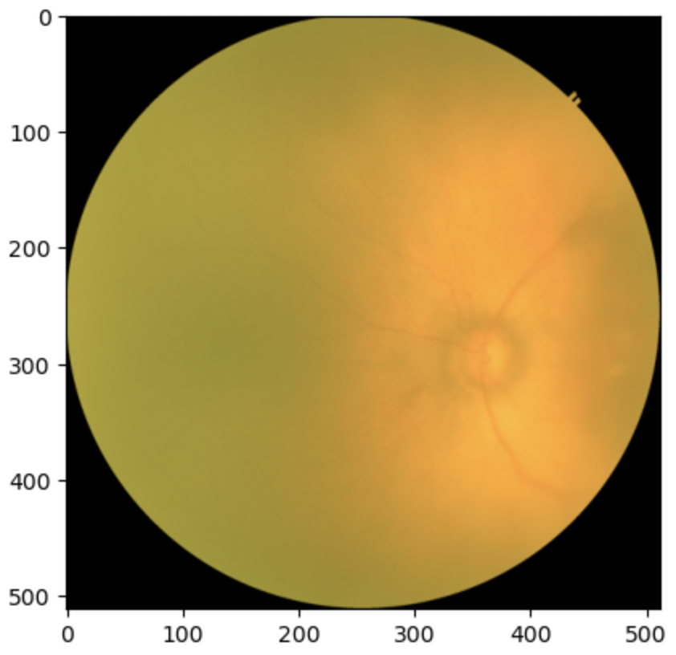
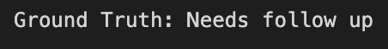
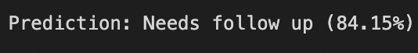
AI Based RoP Detection
Proposed Methodology / Approach
Baseline deep learning model to classify
input images into one of the following categories
Follow up needed
Needs urgent treatment
Discharge from ROP
Training of models for staging, disease detection
Transfer learning from models relating to diabetic retinopathy
Atharva_S_Gadad_Ayush_Gupta_Ayush_Govind_Dhruv_Jyoti_Garodia

Slide 8
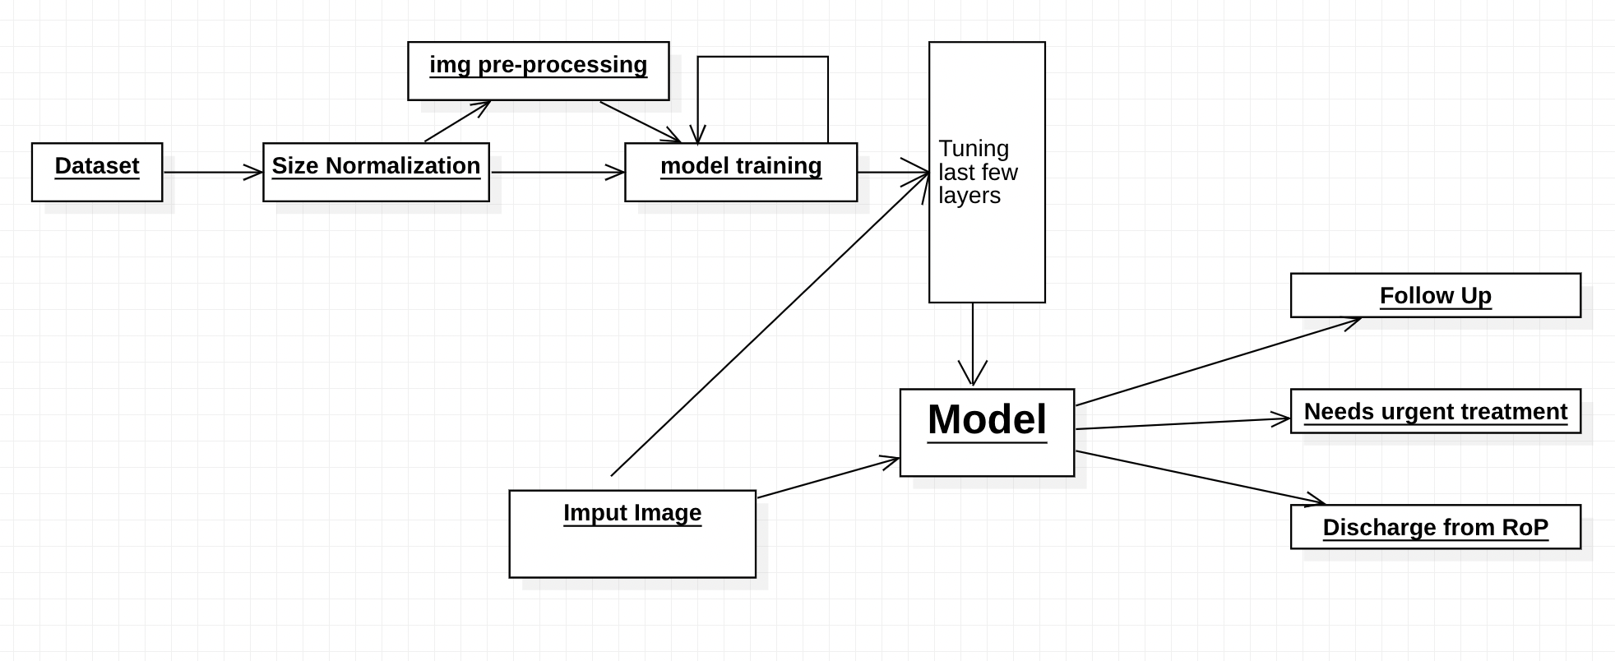
AI Based RoP Detection
Architecture
Providing high-level design view of the system.
Atharva_S_Gadad_Ayush_Gupta_Ayush_Govind_Dhruv_Jyoti_Garodia
Notes:
Identify the logical user groups, application components, data components, and interfacing systems. Illustrate the collaboration and interaction between the major components.

Slide 9
Title of the Project
Design Description
Add as many slides as required to cover the following aspects:
Master class diagram
ER Diagram
User Interface Diagrams/ Use Case Diagrams
Report Layouts
External Interfaces

Slide 10
AI Based RoP Detection
Technologies Used
Pandas - Handling CSVs, Excel spreadsheets, etc. for data cleaning
JSON - Handling large amounts of data
Tensorflow - Implementation of machine learning models
OS - To navigate the directory structure
Shell Scripts - To automate parts of data cleaning
Atharva_S_Gadad_Ayush_Gupta_Ayush_Govind_Dhruv_Jyoti_Garodia

Slide 11
AI Based RoP Detection
Project Demo
MODEL FOR DECISION CLASSIFICATION OF IMAGES
Atharva_S_Gadad_Ayush_Gupta_Ayush_Govind_Dhruv_Jyoti_Garodia

Slide 12
AI Based RoP Detection
Project Progress
The problem of handling large volumes of data has been resolved
Baseline model for classification has been built
Based on current assessment, the project has been completed up to 25% to 30% of its overall scope.
We are constantly monitoring the progress and making adjustments as necessary to ensure that we meet the project objectives within the given timeframe. Our team is committed to delivering high-quality work and meeting our client's expectations.
Atharva_S_Gadad_Ayush_Gupta_Ayush_Govind_Dhruv_Jyoti_Garodia

Slide 13
AI Based RoP Detection
References
Provide references pertaining to your research according to IEEE format.
A. M., K. L. Nisha, S. G., P. S. Sathidevi, P. Mohanachandran and A. Vinekar, "An Efficient Ridge Detection Method for Retinopathy of Prematurity Severity Analysis," 2020 4th International Conference on Intelligent Computing and Control Systems (ICICCS), Madurai, India, 2020, pp. 1210-1215, doi: 10.1109/ICICCS48265.2020.9121101.
This work proposes an efficient segmentation algorithm to detect the ridge in the infant fundus images.
C. Sinthanayothin, S. Barman, “An Automatic Detection of the RoP Demarcation Line/Ridge on infant retinal images”, National Electronics and Computer Technology Center, Thailand and Digital Imaging Research Centre, Kingston University, U.K.
applying Canny Edge Detection on contrast enhanced images
areas exhibiting a high probability of being an ROP ridge region were extracted using a region classification technique and exhibited to the clinician for second decision
Tong Y, Lu W, Deng QQ, Chen C, Shen Y. “Automated identification of retinopathy of prematurity by image-based deep learning”. Eye Vis (Lond). 2020 Aug 1;7:40. doi: 10.1186/s40662-020-00206-2. PMID: 32766357; PMCID: PMC7395360.
ResNet and Faster-RCNN models are trained for classification and identification
applied four fold cross validation to evaluate model performance
Wang J, Ju R, Chen Y, Zhang L, Hu J, Wu Y, Dong W, Zhong J, Yi Z. “Automated retinopathy of prematurity screening using deep neural networks”. EBioMedicine. 2018 Sep;35:361-368. doi: 10.1016/j.ebiom.2018.08.033. Epub 2018 Aug 27. PMID: 30166272; PMCID: PMC6156692.
DNN models, i.e., Id-Net and Gr-Net, were designed for identification and grading tasks
Atharva_S_Gadad_Ayush_Gupta_Ayush_Govind_Dhruv_Jyoti_Garodia
Notes:
1) https://ieeexplore.ieee.org/document/9121101
2) https://www.ncbi.nlm.nih.gov/pmc/articles/PMC7395360/
3) https://eandv.biomedcentral.com/articles/10.1186/s40662-020-00206-2

Slide 14
AI Based RoP Detection
Miscellaneous
Our dataset is the largest of its kind. That gives us a lot of flexibility in terms of experimenting with different ideas to optimize our predictions
Atharva_S_Gadad_Ayush_Gupta_Ayush_Govind_Dhruv_Jyoti_Garodia

Slide 15
AI Based RoP Detection
Thank
You
Atharva_S_Gadad_Ayush_Gupta_Ayush_Govind_Dhruv_Jyoti_Garodia

